Slide 1
Jerusalem, Works of Art at the Israel Museum

Slide 2
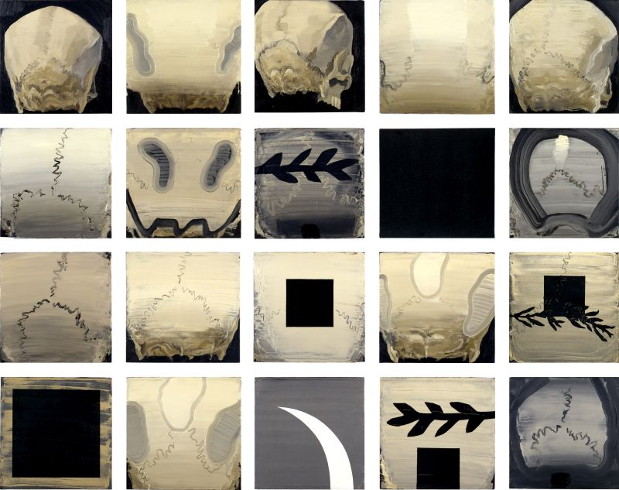
Larry Abramson, Hevel,1989-90
https://www.imj.org.il/en/collections/286502?itemNum=286502

Slide 3
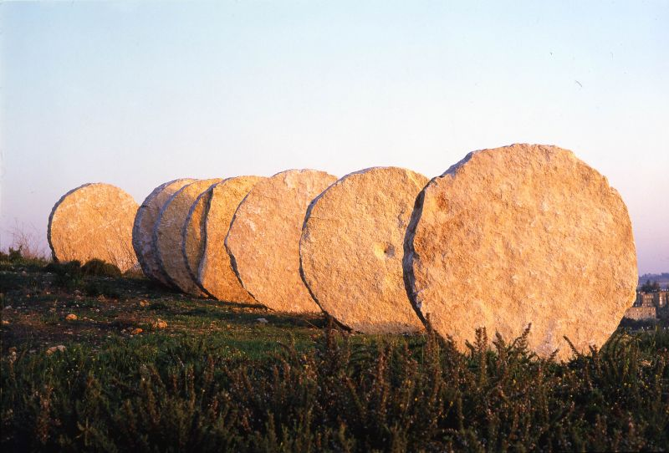
Magdalena Abakanowicz, Negev, 1987
http://www.imj.org.il/en/collections/202028?itemNum=202028

Slide 4
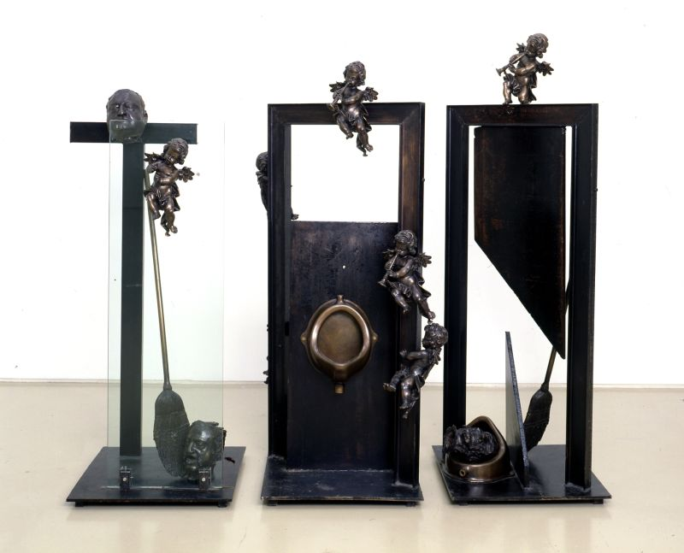
Igael Tumarkin, What I Did to Duchamp, What Duchamp Did to Me (La Passion Selon Marcel)
1995-96
http://www.imj.org.il/en/collections/286204

Slide 5
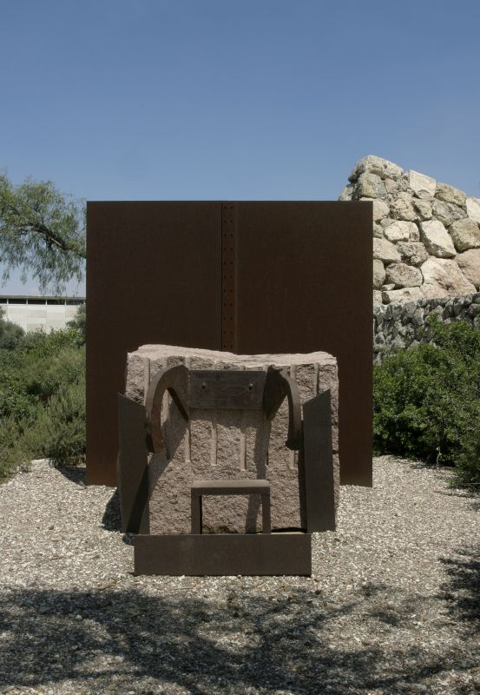
Igael Tumarkin, Chair, Altar, Iron Wall, 1994-95
http://www.imj.org.il/en/collections/290806

Slide 6
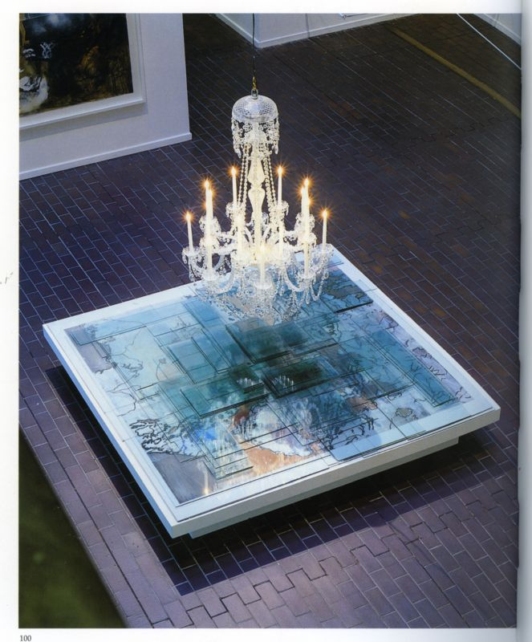
Joshua Neustein, How History Became Geography, 1990
http://www.imj.org.il/en/collections/285878

Slide 7
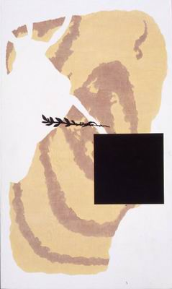
Larry Abramson, Return of the Black Square IV, 1990
http://museum.imj.org.il/imagine/collections/itemCopy.asp?table=comb&itemNum=312007

Slide 8
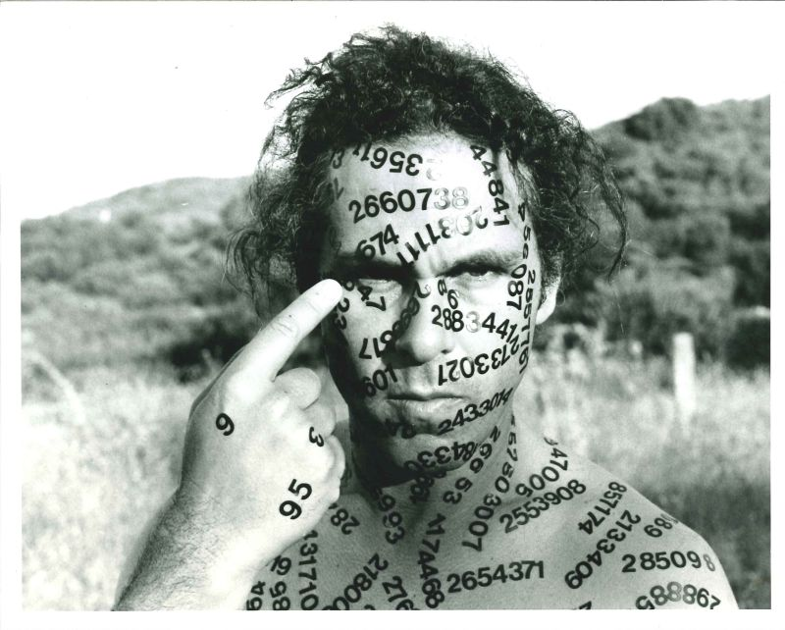
Jonathan Borofsky, Self-Portrait, 1980-87
http://www.imj.org.il/en/collections/390554

Slide 9
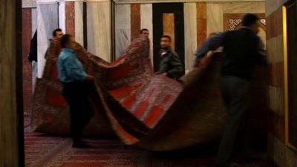
Nira Pereg, Sarah Sarah, 2012
http://www.imj.org.il/en/collections/552130

Slide 10
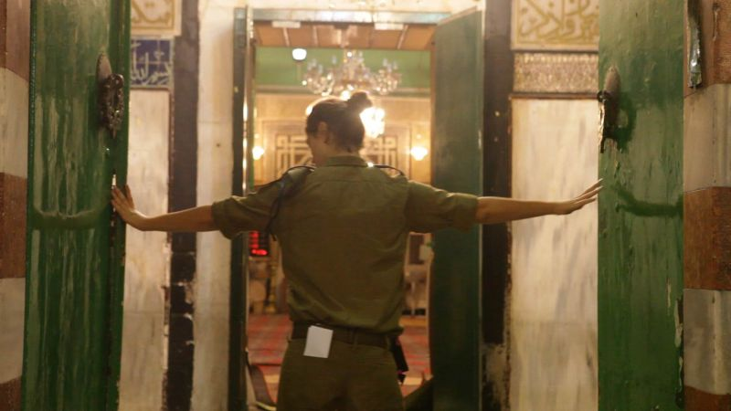
Nira Pereg, Abraham Abraham, 2012
http://www.imj.org.il/en/collections/552129

Slide 11
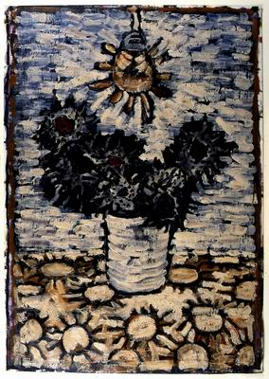
Assem Abu Shakra, Cactus, 1988
http://museum.imj.org.il/imagine/collections/itemCopy.asp?table=comb&itemNum=396073

Slide 12
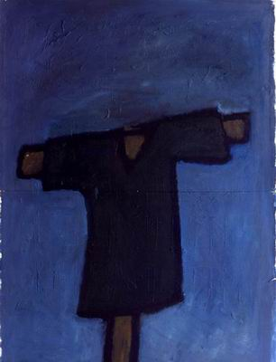
Farid Abu Shakra, Scarecrow in the Wind, 1993 http://museum.imj.org.il/imagine/collections/itemCopy.asp?table=comb&itemNum=285905

Slide 13
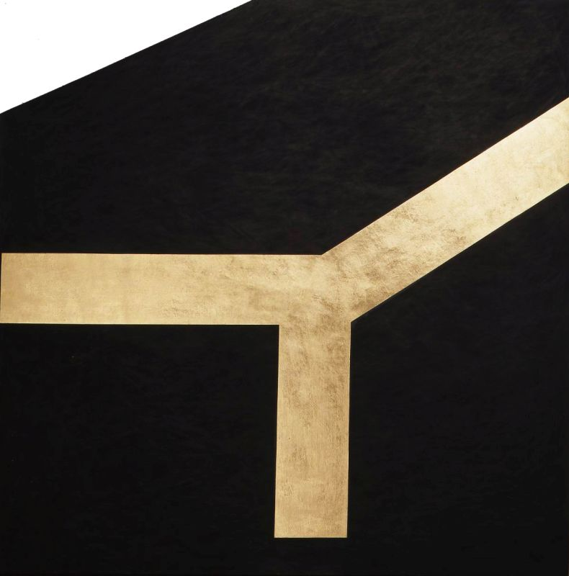
Joshua Borkovsky, Pilgrimage, 1982
http://www.imj.org.il/en/collections/365329?itemNum=365329

Slide 14
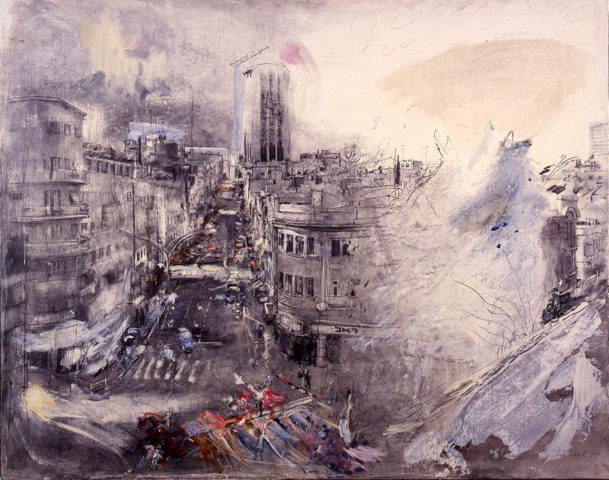
Ivan Schwebel, Zion Square, 1979
http://www.imj.org.il/en/collections/283392?itemNum=283392

Slide 15
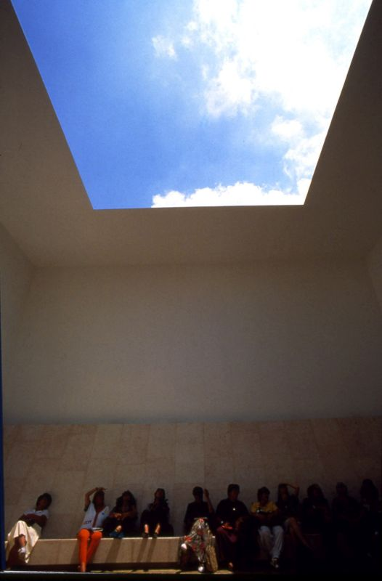
James Turrell, Space That Sees, 1992
http://www.imj.org.il/en/collections/199801?itemNum=199801

Slide 16
Wim Wenders, German, The Road to Emmaus, Near Jerusalem, 2003.
http://www.imj.org.il/en/collections/322256?itemNum=322256

Slide 17
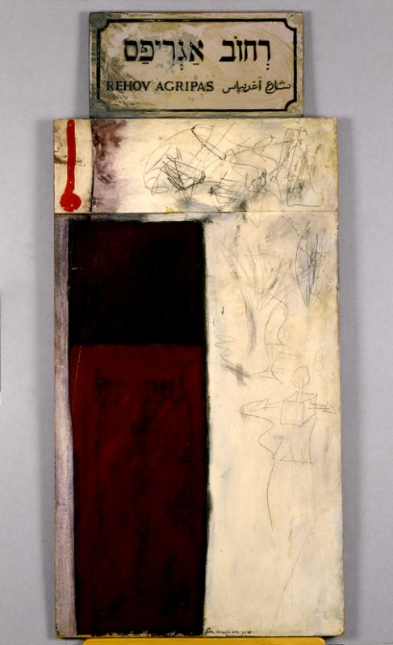
Arie Aroch, Agripas Street, 1964
http://www.imj.org.il/en/collections/202295?itemNum=202295

Slide 18
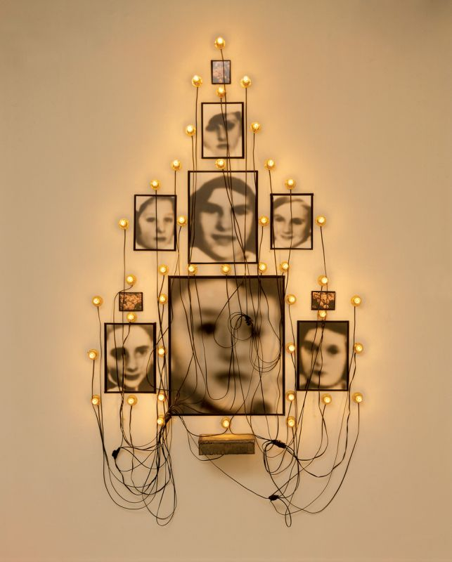
Christian Boltanski, The Festival of Purim (La Fête de Purim), 1988
http://www.imj.org.il/en/collections/390523?itemNum=390523

Slide 19
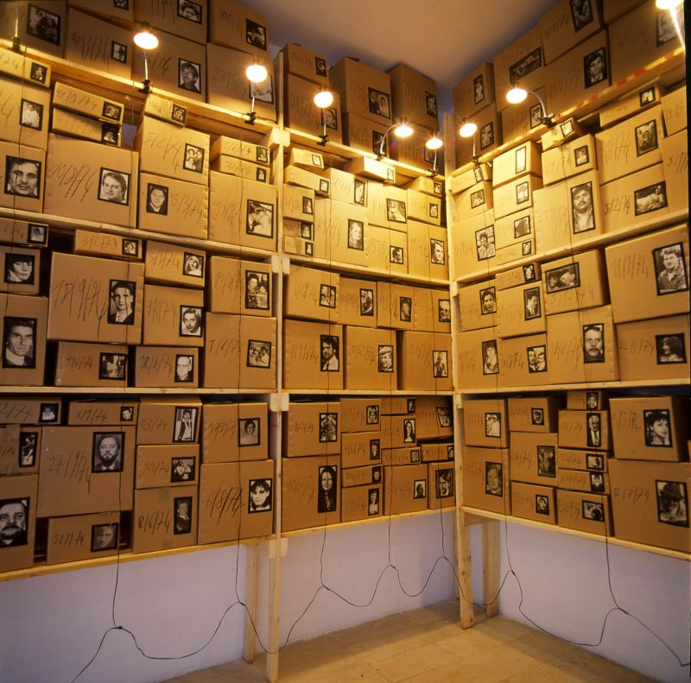
Christian Boltanski, The Archives - "Detective", 1988-89
http://www.imj.org.il/en/collections/390529

Slide 20
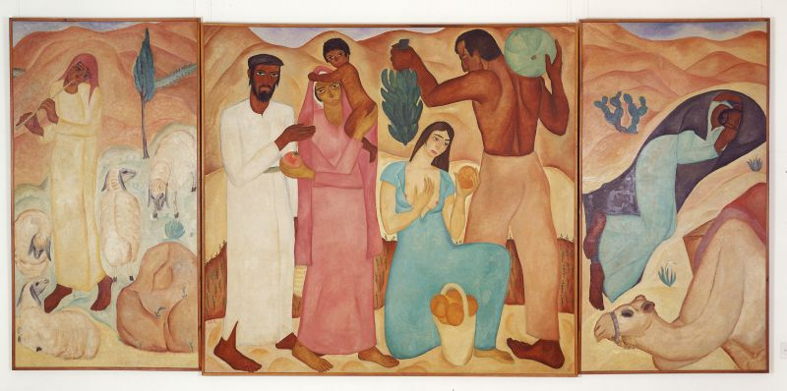
Reuven Rubin, First Fruits, 1923
http://www.imj.org.il/en/collections/403452?itemNum=403452

Slide 21
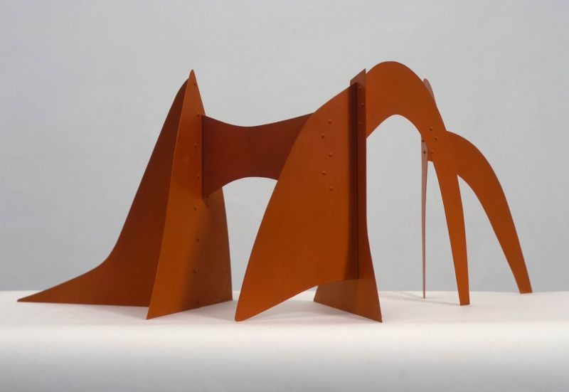
Alexander Calder, Maquette for the Jerusalem Stabile, 1976.
http://www.imj.org.il/en/collections/193739?itemNum=193739

Slide 22
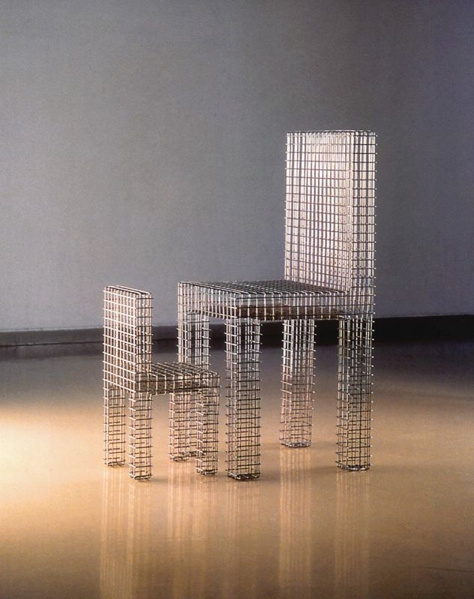
Mona Hatoum, Untitled, 1992
http://www.imj.org.il/en/collections/308136?itemNum=308136

Slide 23
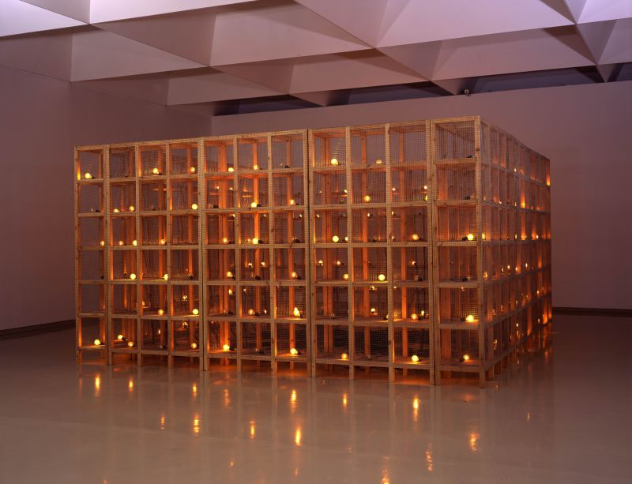
Mona Hatoum, Current Disturbance, 1996.
http://www.imj.org.il/en/collections/202251?itemNum=202251

Slide 24
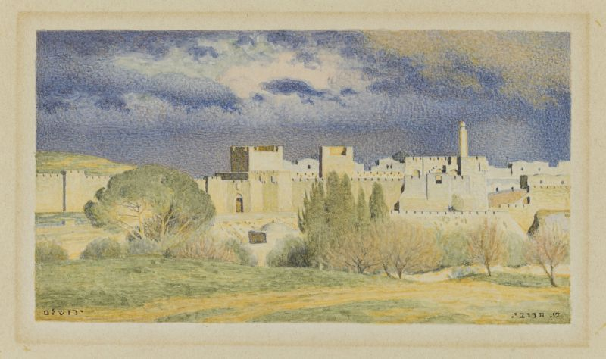
Shmuel Charuvi, Jerusalem, 1920s
http://www.imj.org.il/en/collections/607976?itemNum=607976

Slide 25
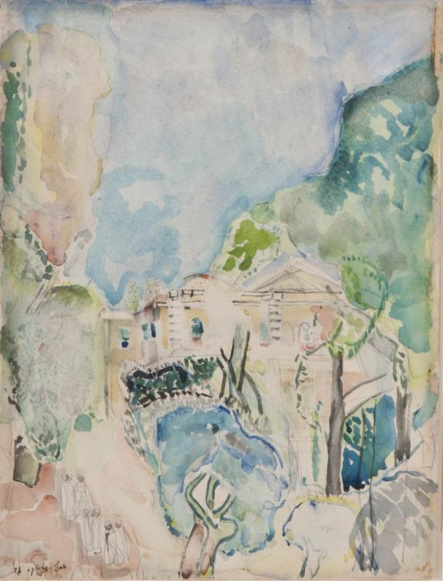
Yossef Zaritsky, Dr. Ticho's House, View from the Garden, 1926
http://www.imj.org.il/en/collections/524507?itemNum=524507

Slide 26
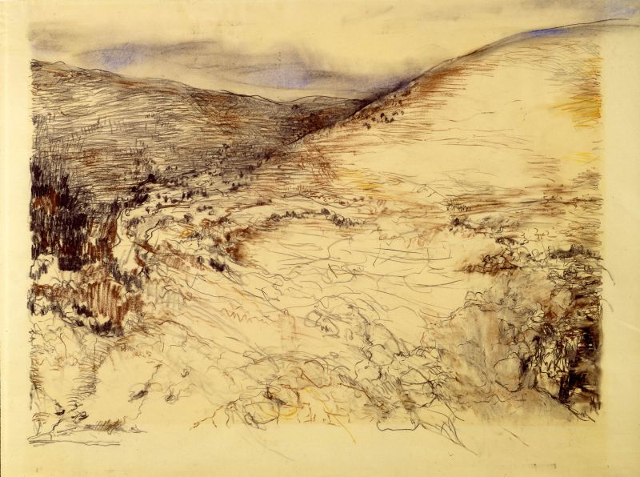
Anna Ticho, Judean Hills, ca. 1970
https://www.imj.org.il/en/collections/202861?itemNum=202861

Slide 27
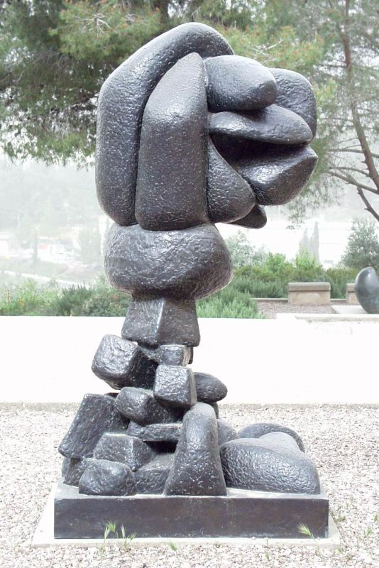
Otto Freundlich, Ascension, 1929.
http://www.imj.org.il/en/collections/191629?itemNum=191629

Slide 28
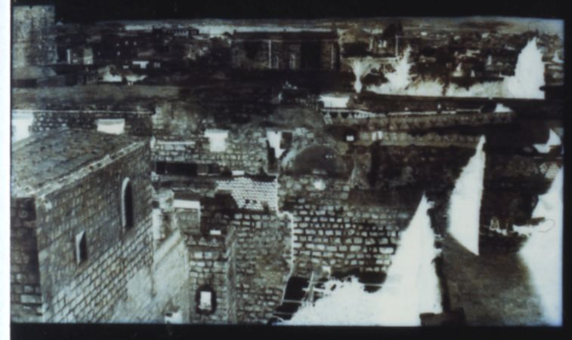
Louis de Clercq, View of the Jerusalem Walls, 1859
http://www.imj.org.il/en/collections/310208?itemNum=310208

Slide 29
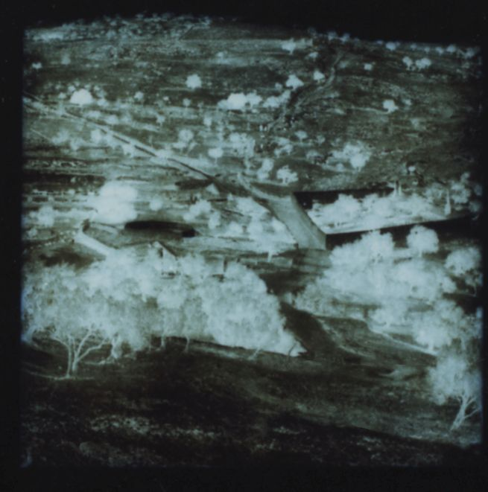
Louis de Clercq, Garden of Gethsemane and the Mount of Olives, 1859
http://www.imj.org.il/en/collections/310203

Slide 30
Louis de Clercq, View of the Jerusalem Walls, 1859
http://www.imj.org.il/en/collections/310208

Slide 31
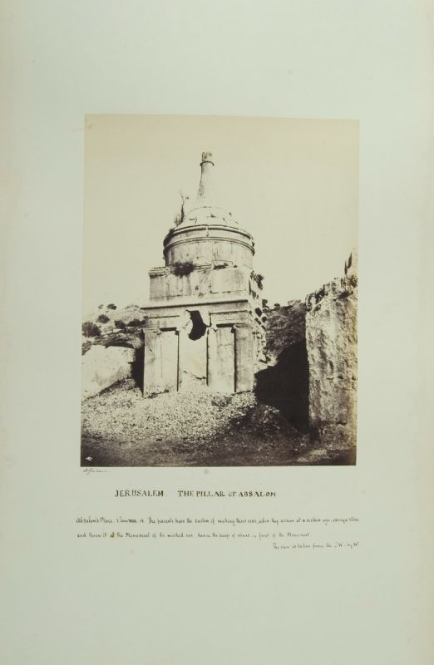
James Graham, Jérusalem, album of 87 albumen prints, 1853-57
http://www.imj.org.il/en/collections/320959

Slide 32
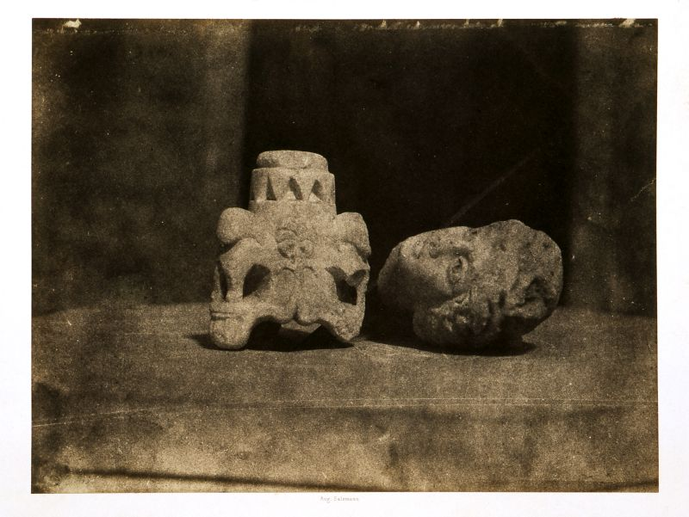
August Salzmann, Fragments Judaïque et Romain, 1854
http://www.imj.org.il/en/collections/202376

Slide 33
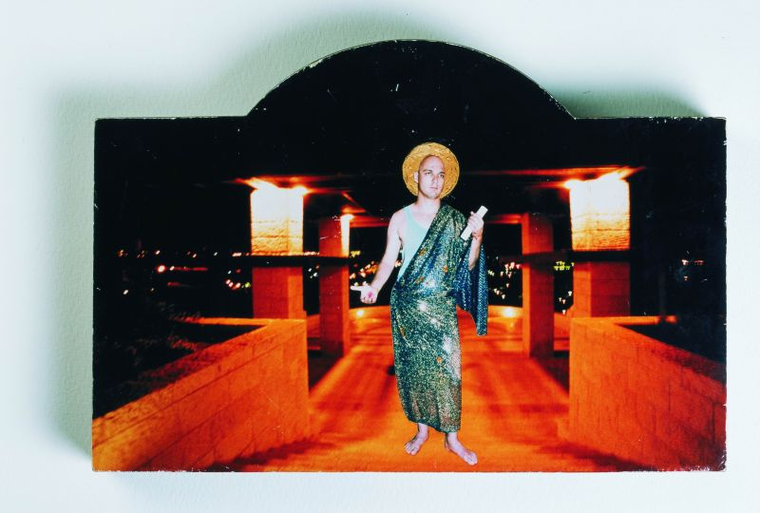
Ayelet Hashachar Cohen, Israeli, Jerusalem 1995, 1995
http://www.imj.org.il/en/collections/309032?itemNum=309032

Slide 34
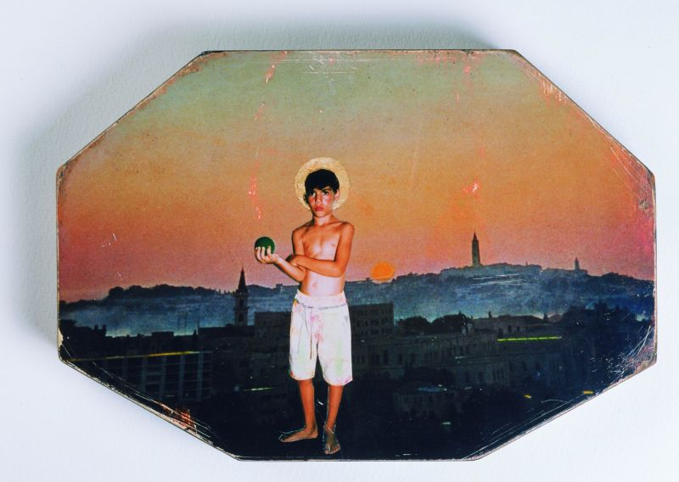
Ayelet Hashachar Cohen, Jerusalem 1995, 1995
http://www.imj.org.il/en/collections/309051?itemNum=309051

Slide 35
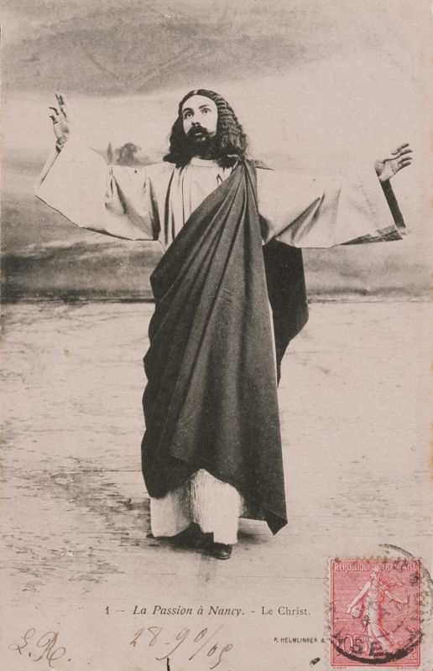
Unidentified, La Passion à Nancy, 1905
http://www.imj.org.il/en/collections/323130

Slide 36
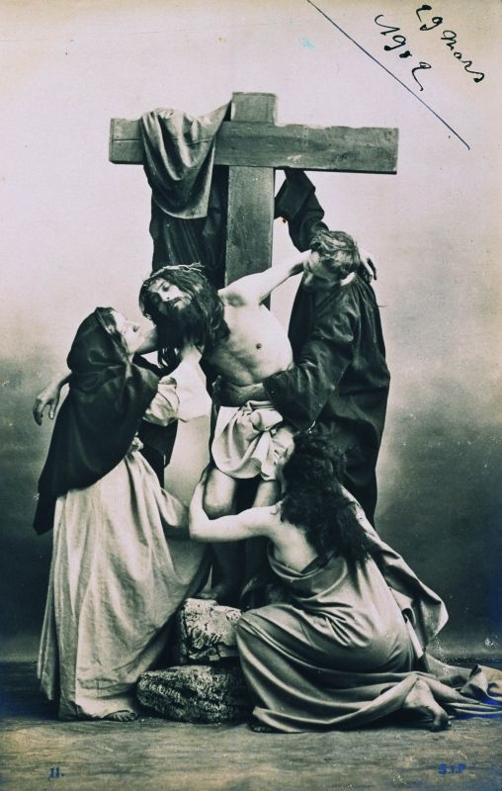
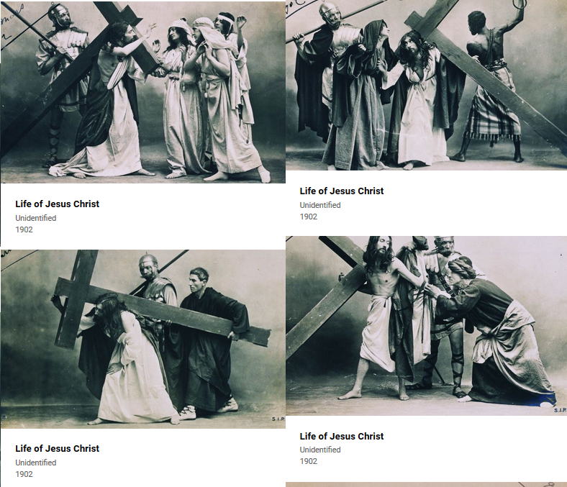
Unidentified, Life of Jesus Christ, 1902
http://www.imj.org.il/en/collections/311494

Slide 37
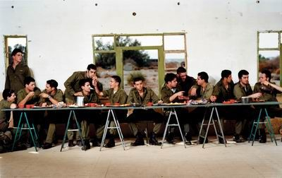
Adi Nes, Untitled, 1999
http://www.imj.org.il/en/collections/202486?itemNum=202486

Slide 38
Rauf Mamedov, The Last Supper, 1998.
http://museum.imj.org.il/imagine/collections/itemCopy.asp?itemNum=309444

Slide 39
Andres Serrano, Black Supper, 1990
http://museum.imj.org.il/imagine/collections/itemCopy.asp?itemNum=311477

Slide 40
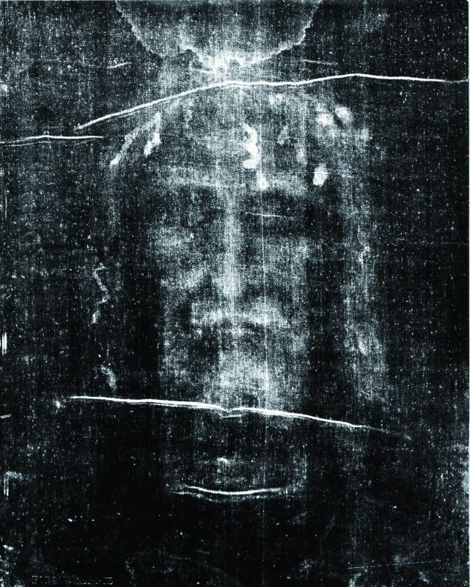
Giuseppe Enrie, The Shroud of Turin, 1931
http://www.imj.org.il/en/collections/309448

Slide 41
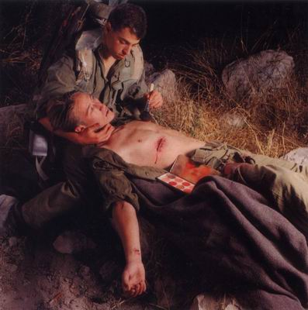
Adi Nes, Untitled, 1995
http://museum.imj.org.il/imagine/collections/itemCopy.asp?itemNum=308938

Slide 42
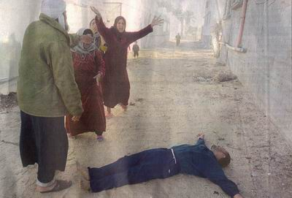
Pavel Wohlberg, Gush Katif, 2001.
http://museum.imj.org.il/imagine/collections/itemCopy.asp?itemNum=308921

Slide 43
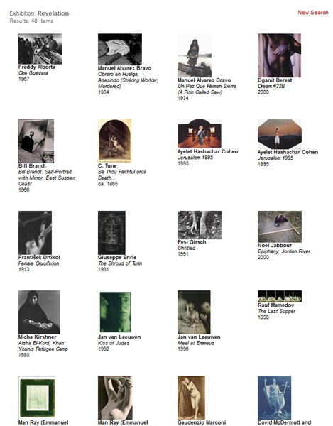
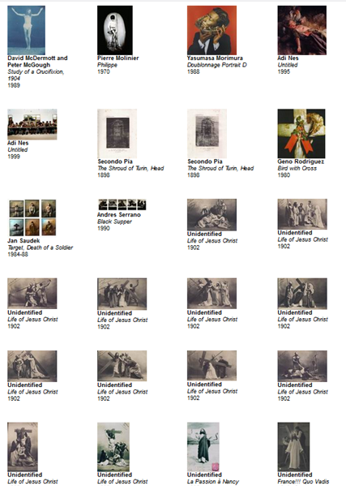
See also these works in the Israel Museum from the Revelation exhibition
http://museum.imj.org.il/imagine/collections/exhibitions/10?

Slide 44
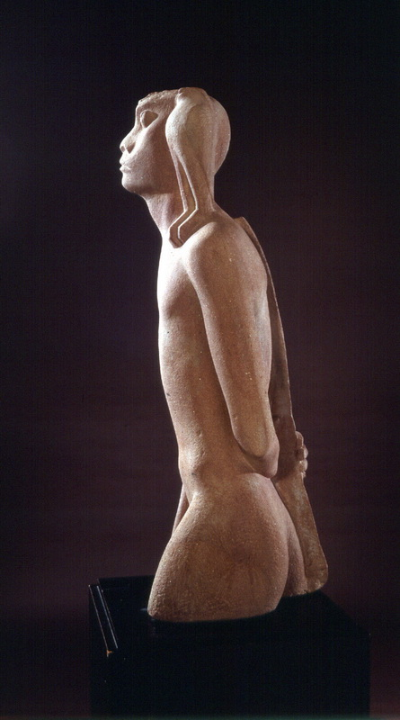
Itzhak Danziger, Nimrod, 1939
http://www.imj.org.il/en/collections/73486?itemNum=73486

Slide 45
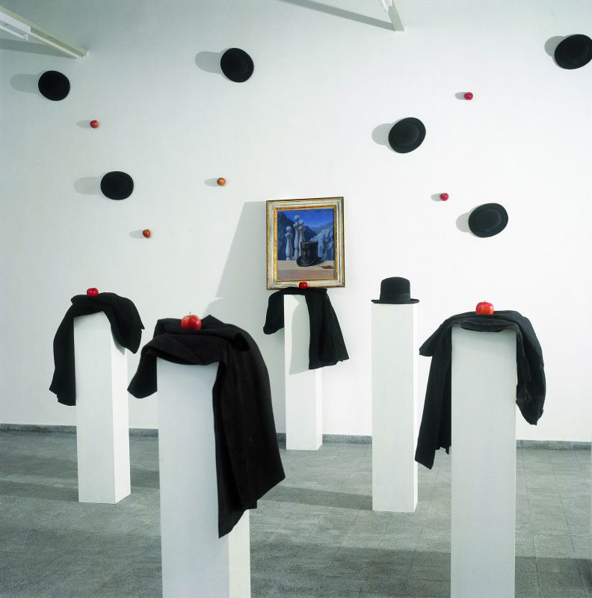
Braco Dimitrijević, Triptychos Post Historicus, 1990
http://www.imj.org.il/en/collections/291932?itemNum=291932

Slide 46
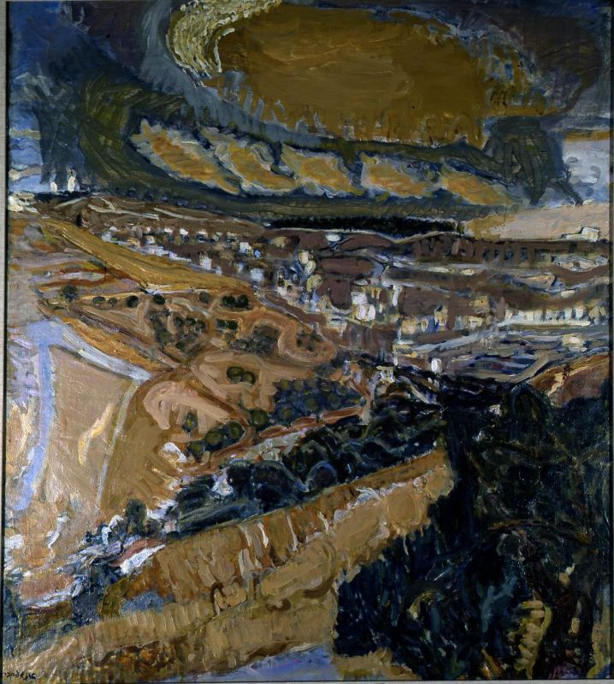
Leon Engelsberg, Jerusalem Landscape, 1961
http://www.imj.org.il/en/collections/296560?itemNum=296560

Slide 47
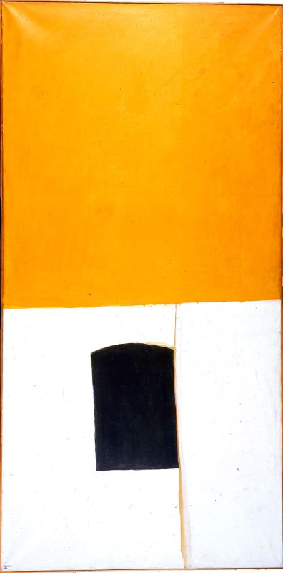
Michael Gross, Roof and Window in Jerusalem, 1966-67
http://www.imj.org.il/en/collections/370864?itemNum=370864

Slide 48
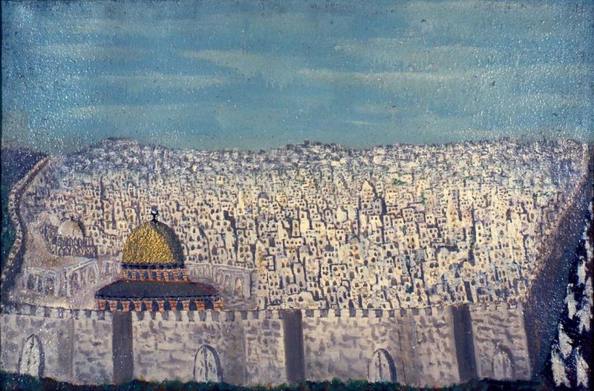
Gabriel Cohen, Jerusalem 1973
http://www.imj.org.il/en/collections/368516?itemNum=368516

Slide 49
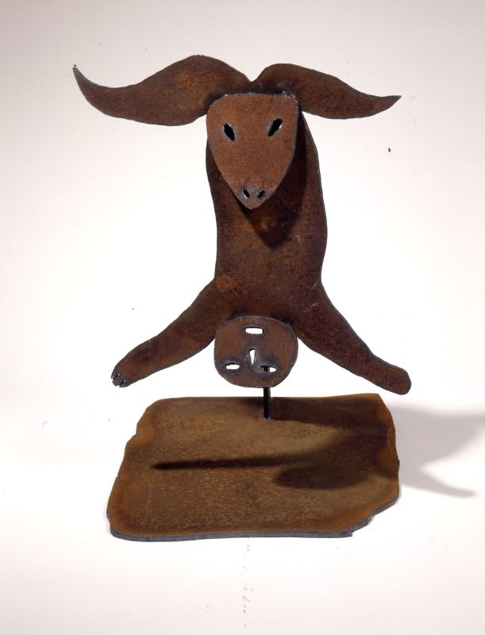
Menashe Kadishman, The Sacrifice of Isaac, 1982-84
http://www.imj.org.il/en/collections/286468

Slide 50
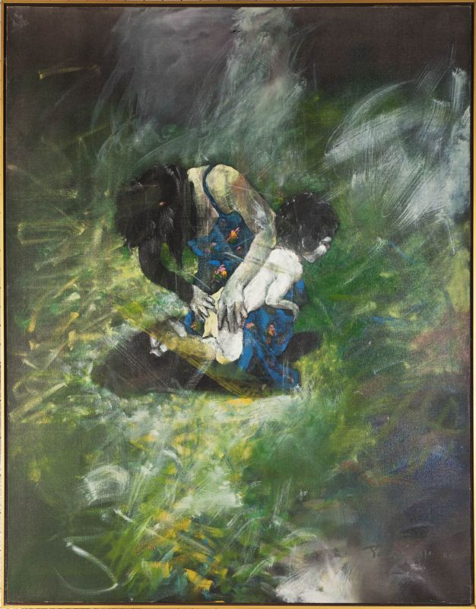
Uri Lifschitz, Sacrifice of Isaac, 1977-78
http://www.imj.org.il/en/collections/549110

Slide 51
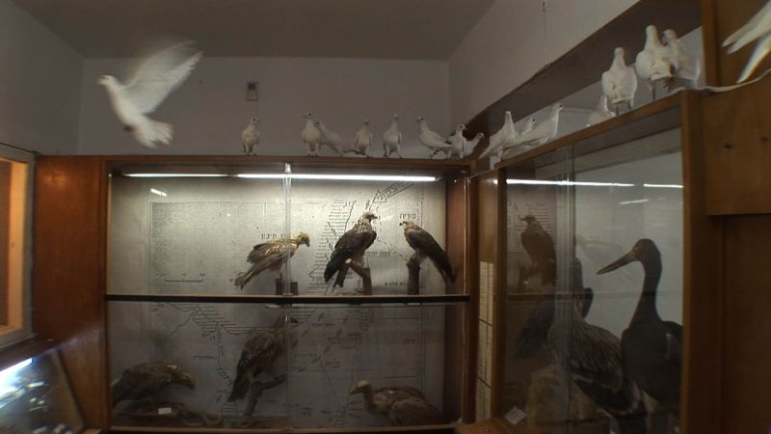
Dana Levy, Silent Among Us, 2008
http://www.imj.org.il/en/collections/479421

Slide 52
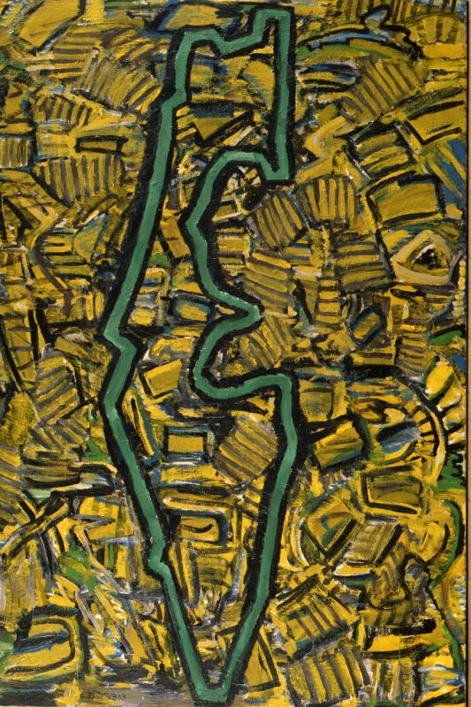
David Reeb, The Green Line, 1985
http://www.imj.org.il/en/collections/312001

Slide 53
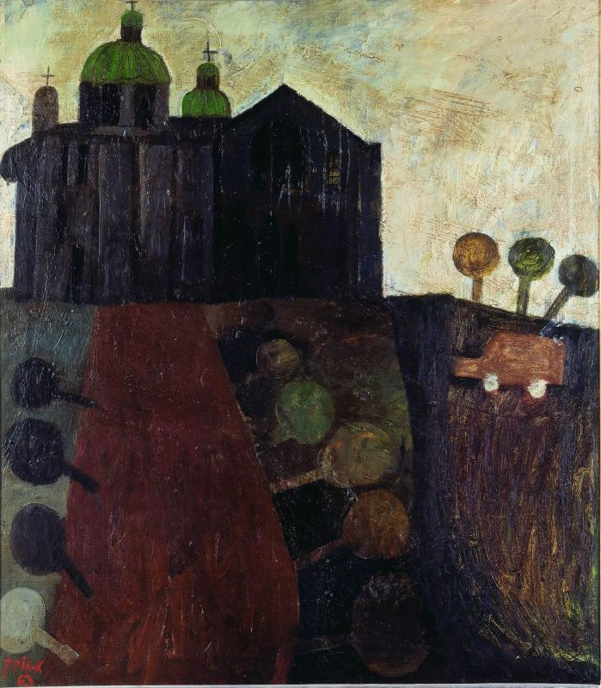
Avraham Ofek, Jerusalem, the Russian Compound, 1963
http://www.imj.org.il/en/collections/283384?itemNum=283384

Slide 54
Assaf Romano, Shlomzion, 2002
http://www.imj.org.il/en/collections/443608

Slide 55
Angela Strassheim, Untitled (horses), 2004
https://www.imj.org.il/en/collections/324002?itemNum=324002

Slide 56
Jacob Pins, White Sky Above Jerusalem, 1980
http://www.imj.org.il/en/collections/445040?itemNum=445040

Slide 57
Erich Mendelsohn, The Schocken House, 1934-1936
http://www.imj.org.il/en/collections/221922?itemNum=221922

Slide 58
Geppler, God Crying (Caricature), Undated
http://www.imj.org.il/en/collections/252771?itemNum=252771

Slide 59
Salvador Dalí, The Wailing Wall, 1989
http://museum.imj.org.il/imagine/collections/itemCopy.asp?table=comb&itemNum=243939

Slide 60
Jean-Leon Gerome, A Jew at the Wall of the Temple of Solomon in Jerusalem, ca. 1877
http://www.imj.org.il/en/collections/308881?itemNum=308881

Slide 61
Ephraim Moses Lilien, An Allegorical Wedding: Sketch for a carpet dedicated to Mr. and Mrs. David Wolffsohn, Triptych (from right to left): Exile, Marriage, Redemption, 1906
http://www.imj.org.il/en/collections/298075?itemNum=298075

Slide 62
Blue Cypress carpet, Israel, 1920-31
http://www.imj.org.il/en/collections/353807?itemNum=353807

Slide 63
Edward Lear, Jerusalem from the Mount of Olives, 1858-59
http://www.imj.org.il/en/collections/370918?itemNum=370918

Slide 64
Edward Lear, View of Jerusalem from the Mount of Olives, 1858
http://www.imj.org.il/en/collections/308777?itemNum=308777

Slide 65
David Roberts, Jerusalem, 1845.
http://www.imj.org.il/en/collections/506539?itemNum=506539

Slide 66
Joseph Mallord William Turner, North-West View of Jerusalem, 1832-34.
http://www.imj.org.il/en/collections/308778?itemNum=308778

Slide 67
Joseph Mallord William Turner, Jerusalem from the Mount of Olives, 1834-35.
http://www.imj.org.il/en/collections/506540?itemNum=506540

Slide 68
Rembrandt van Rijn, St. Peter in Prison (St. Peter Kneeling), 1631
http://www.imj.org.il/en/collections/191478?itemNum=191478

Slide 69
Mark Wallinger, Ecce Homo, 1999
http://www.imj.org.il/en/collections/199788?itemNum=199788

Slide 70
Maurycy Gottlieb, Christ before His Judges, 1877–79 http://museum.imj.org.il/imagine/collections/itemCopy.asp?table=comb&itemNum=376078

Slide 71
Samuel Hirszenberg, The Wandering Jew (or The Eternal Jew), 1899
http://museum.imj.org.il/en/audioguides/jesus/page/?id=734

Slide 72
Jakob Steinhardt, The Temple , 1925-30
http://www.imj.org.il/en/collections/400275?itemNum=400275

Slide 73
Motti Mizrachi,Via Dolorosa, 1973
http://museum.imj.org.il/en/audioguides/jesus/page/?id=742

Slide 74
Motti Mizrachi, Facing the City, 1975
http://www.imj.org.il/en/collections/296746

Slide 75
Nahum Miller, Apocalypsa, 1987
http://www.imj.org.il/en/collections/388539

Slide 76
Jan van Leeuwen, Kiss of Judas, 1992.
http://museum.imj.org.il/imagine/collections/itemCopy.asp?itemNum=323127

Slide 77
Leonora Carrington, Assurbanipal Abluting Harpies, 1958
http://museum.imj.org.il/imagine/collections/itemCopy.asp?table=comb&itemNum=192995

Slide 78
Albrecht Dürer, The Presentation of the Virgin in the Temple, from "The Life of the Virgin"
http://www.imj.org.il/en/collections/578404?itemNum=578404

Slide 79
Alfred Bernheim, Minaret, Jerusalem, Undated
http://www.imj.org.il/en/collections/511967?itemNum=511967

Slide 80
See also:
Alfred Bernheim, Welcome Home inscription for Mecca pilgrim, Old City, Jerusalem, Undated
http://www.imj.org.il/en/collections/511620?itemNum=511620
See also:

Slide 81
Alfred Bernheim, Via Dolorosa, Jerusalem, Undated
https://www.imj.org.il/en/collections/512202?itemNum=512202

Slide 82
Alfred Bernheim, Damascus Gate, Jerusalem, before 1967
https://www.imj.org.il/en/collections/511685?itemNum=511685

Slide 83
Alfred Bernheim, Banister, Jerusalem, undated
https://www.imj.org.il/en/collections/511636?itemNum=511636

Slide 84
Alfred Bernheim, Embroidered Dress, undated
https://www.imj.org.il/en/collections/511697?itemNum=511697

Slide 85
Alfred Bernheim, Golden Gate, view from Haram esh-Sharif, undated
https://www.imj.org.il/en/collections/511726?itemNum=511726

Slide 86
Alfred Bernheim, Near Jaffa Gate, Jerusalem, after 1967
https://www.imj.org.il/en/collections/511770

Slide 87
Alfred Bernheim, Haram esh-Sharif, Jerusalem, undated
https://www.imj.org.il/en/collections/511749?itemNum=511749

Slide 88
Alfred Bernheim, Anglo-Palestine Bank, Jerusalem, 1936-9
https://www.imj.org.il/en/collections/512445?itemNum=512445

Slide 89
Alfred Bernheim, Shrine of the Book, The Israel Museum, Jerusalem
https://www.imj.org.il/en/collections/514978?itemNum=514978

Slide 90
Rabbi Ya’akov Meir, Jerusalem, Early 20th century
http://www.imj.org.il/en/collections/516669?itemNum=516669

Slide 91
David and Rina Davidoff, after their betrothal dressed in Bukharan traditional festive attire,
Jerusalem, 1927
http://www.imj.org.il/en/collections/516645?itemNum=516645

Slide 92
August Salzmann, Fragments Judaï que et Romain, 1854
http://www.imj.org.il/en/collections/202376?itemNum=202376

Slide 93
Nicolas Poussin, The Destruction and Sack of the Temple of Jerusalem, 1625-26
http://www.imj.org.il/en/collections/199789?itemNum=199789

Slide 94
Sukkah, Fishach, Southern Germany, Second half of the 19th century
http://www.imj.org.il/en/collections/199807?itemNum=199807

Slide 95
Painted Sukkah Boards, Szeged, Hungary, Late 19th or early 20th century
http://www.imj.org.il/en/collections/366619?itemNum=366619

Slide 96
Interior of the Horb synagogue, Horb am Main, Germany
Artist: Eliezer Sussman of Brody, 1735
http://www.imj.org.il/en/collections/199707?itemNum=199707

Slide 97
Interior of the Vittorio Veneto synagogue, Northern Italy, 1700
http://www.imj.org.il/en/collections/200184?itemNum=200184

Slide 98
Interior of the Kadavumbagam synagogue, Cochin, Southern India, date of construction: http://www.imj.org.il/en/collections/199804?itemNum=199804539-44

Slide 99
Gold-glass base, Rome, 4th century CE
http://www.imj.org.il/en/collections/228663?itemNum=228663

Slide 100
Plaque commemorating the destruction of the Temple, Jerusalem, late 19th century
http://www.imj.org.il/en/collections/368680?itemNum=368680

Slide 101
Jakob Steinhardt, Neighborhood in Jerusalem, 1934
http://www.imj.org.il/en/collections/398406?itemNum=398406
See also:

Slide 102
Jakob Steinhardt, Apocalyptic Landscape, 1912
http://www.imj.org.il/en/collections/193513?itemNum=193513

Slide 103
Gil Marco Shani, Untitled, 2006-2007
http://www.imj.org.il/en/collections/309947?itemNum=309947

Slide 104
Frank Stella, Damascus Gate, 1969
http://www.imj.org.il/en/collections/192773?itemNum=192773

Slide 105
Moshe Tamir, Jerusalem Landscape/Wild Landscape, 1954.
http://www.imj.org.il/en/collections/443611?itemNum=443611

Slide 106
Liselotte Grschebina, Bukharan girl, Jerusalem, 1937, http://www.imj.org.il/en/collections/342042?itemNum=342042
See also:

Slide 107
Temple Menorah and Bar Kokhba coins, Jerusalem, Sharar workshop, Bezalel, 1914-29
http://www.imj.org.il/en/collections/359240?itemNum=359240

Slide 108
Hassidic Sabbath attire, Jerusalem, late 20th century
http://www.imj.org.il/en/collections/362824?itemNum=362824

Slide 109
Pendant or brooch with a depiction of a Yemenite girl, New Bezalel, Jerusalem, 1950s
http://www.imj.org.il/en/collections/369317?itemNum=369317

Slide 110
Medallion with a depiction of Absalom’s Tomb, Bezalel, Jerusalem, Artist: Reuven Leaf (Lifshitz), 1913-29
http://www.imj.org.il/en/collections/370467?itemNum=370467
See also:

Slide 111
Desk set with inkstand decorated with a depiction of the Dome of the Rock representing the site of the Temple, Bezalel School of Arts and Crafts, Jerusalem, ca. 1913 http://www.imj.org.il/en/collections/379547?itemNum=379547
See also:

Slide 112
Ze'ev Raban, Come to Palestine, 1929
https://www.imj.org.il/en/collections/221921?itemNum=221921

Slide 113
Hallah cover, Jerusalem, Land of Israel, late 19th century
http://www.imj.org.il/en/collections/589286?itemNum=589286

Slide 114
“Priestly Benediction” on amulets, Ketef Hinnom, Jerusalem, 6th century BCE
http://www.imj.org.il/en/collections/198069?itemNum=198069

Slide 115
To the place of trumpeting …,” Hebrew inscription on a parapet from the Temple Mount Western Wall excavations at the south-western corner of the Temple Mount, Jerusalem, Herodian period, 1st century BCE
http://museum.imj.org.il/imagine/collections/itemCopy.asp?itemNum=191539

Slide 116
“(Belonging) to Eliyahu,” Hebrew inscription on a jug, Jerusalem, Iron Age II, late 8th century BCE
http://www.imj.org.il/en/collections/380295?itemNum=380295

Slide 117
Royal capital, Jerusalem, Iron Age II, 9th-7th century BCE
http://www.imj.org.il/en/collections/365058?itemNum=365058

Slide 118
Epitaph of King Uzziah of Judah, Jerusalem, 1st century BCE - 1st century CE
http://www.imj.org.il/en/collections/353190?itemNum=353190

Slide 119
The Temple Scroll (11Q20), Qumran Cave 11, Late 1st century BCE - early 1st century CE
http://www.imj.org.il/en/collections/198212?itemNum=198212
See also:
http://museum.imj.org.il/imagine/collections/exhibitions/13?

Slide 120
Ido Michael, Bank Hapoalim Carpet, 2013
http://www.imj.org.il/en/collections/550191

Slide 121
Holy of Holies from the sanctuary at Arad, Iron Age II, 8th century BCE
http://www.imj.org.il/en/collections/369406?itemNum=369406

Slide 122
Seal impression from legal archive: (Belonging) to Rephayahu son of Ephrah, City of David, Jerusalem, Iron Age II, 6th century BCE
http://www.imj.org.il/en/collections/368296?itemNum=368296
See also:

Slide 123
Jewish coin of the First Jewish War, Shekel (silver),
Mint: Jerusalem, 68-69 CE
http://www.imj.org.il/en/collections/371069?itemNum=371069
See also:

Slide 124
Horse figurine, City of David, Jerusalem, Iron Age II, 8th century BCE
http://www.imj.org.il/en/collections/369816?itemNum=369816

Slide 125
Female figurine, Jerusalem, Iron Age II, 8th century BCE
http://www.imj.org.il/en/collections/370895?itemNum=370895

Slide 126
After Hieronymous Bosch; Published by Hieronymous Cock, The Last Judgment (triptych), Late 15th century - early 16th century
http://www.imj.org.il/en/collections/206102?itemNum=206102

Slide 127
Pieter van der Heyden After Peter Brueghel the Elder, The Last Judgment, 1558
http://www.imj.org.il/en/collections/206244?itemNum=206244

Slide 128
Albrecht Dürer, The Adoration of the Lamb – The Hymn of the Chosen, from "The Apocalypse", woodcut, ca. 1496-1497
http://www.imj.org.il/en/collections/578676?itemNum=578676

Slide 129
Lucas Cranach the Elder, The Crown of Thorns, from "The Passion of Christ", woodcut, undated
http://www.imj.org.il/en/collections/580594?itemNum=580594

Slide 130
René Magritte, The Last Judgment (Le judgment dernier), 1935
http://www.imj.org.il/en/collections/252266?itemNum=252266

Slide 131
Luc Tuymans, Nuclear Plant, 2006
https://www.imj.org.il/en/collections/391294?itemNum=391294

Slide 132
Heinrich Bünting, The Whole World in the Form of a Three-Leafed Clover, 1581
http://www.imj.org.il/en/collections/289677?itemNum=289677

Slide 133
Frans Hogenberg, Flemish, 1535-1590, after Christian Van Adrichom, Dutch, 1533-1585,
Imaginary Plan of Ancient Jerusalem and Its Suburbs at the Time of Jesus, 1590
http://www.imj.org.il/en/collections/289266?itemNum=289266

Slide 134
Giovanni Francesco Camocio, Civitas Hierusalem (The City of Jerusalem), Venice, Italy, ca. 1570
http://www.imj.org.il/en/collections/293902?itemNum=293902

Slide 135
Hartmann Schedel, The Destruction of Jerusalem, 1493
http://www.imj.org.il/en/collections/292732?itemNum=292732

Slide 136
Matthaeus Seutter, Map of ancient Jerusalem after Villalpando and a Bird's-eye View of the City
after M. Merian, ca. 1734
http://www.imj.org.il/en/collections/289280?itemNum=289280

Slide 137
Pierre le Rouge, French, 15th century, after Lucas Brandis de Schass, German, 15th century, Map of the Holy Land, 1488
http://www.imj.org.il/en/collections/199800?itemNum=199800

Slide 138
Willem Albert Bachiene, A Map of the Land of Canaan, 1757
http://museum.imj.org.il/imagine/collections/itemCopy.asp?table=comb&itemNum=289673

Slide 139
The Regensburg Pentateuch, Pentateuch, Five Scrolls, Haftarot, Job, Jeremiah 2:29, 8:12; 9:24; 10:15; Masorah magna and parva, Regensburg, Bavaria, Germany, Scribes: David ben Shabetai; Baruch
Masorates: Jacob ben Meir and three others, unidentified, ca. 1300
http://www.imj.org.il/en/collections/201636?itemNum=201636

Slide 140
Illustrated Passover Haggadah, Hamburg, Germany, 1762
Scribe and illustrator: Nethanel son of Aaron [ha־Levi] Segal
http://museum.imj.org.il/imagine/collections/itemCopy.asp?table=comb&itemNum=397350

Slide 141
King Nimrod Flying to Heaven, Folio from Rawdat al-Safa (The Garden of Purity) of Mirkhwand, Baghdad, Iraq, 1599
http://www.imj.org.il/en/collections/300603?itemNum=300603

Slide 142
King Kay Kaos ascends to heaven, Folio from the Shahnama (Book of Kings) of Firdawsi, Isfahan, Iran, 1620-40
http://www.imj.org.il/en/collections/509290?itemNum=509290

Slide 143
King David orders the execution of a prisoner, Folio from a religious text, Iran or India, Late 17th Century
http://www.imj.org.il/en/collections/301217?itemNum=301217

Slide 144
Moshe Shah Mizrahi (?), Site of the Temple, First half of the 20th century
http://www.imj.org.il/en/collections/368867?itemNum=368867

Slide 145
Torah ark doors from the synagogue of Rabbi Moses Isserles (the Rema), Kraków, Poland, Artists: Zalman, Hayim, and Anya(?) Schnitzer and Welwel K.S., Early 17th century
http://www.imj.org.il/en/collections/366114?itemNum=366114

Slide 146
Statue of the Emperor Hadrian, Camp of the Sixth Roman Legion, Tel Shalem, Beth Shean Valley, Roman period, 117-138 CE
http://www.imj.org.il/en/collections/198089?itemNum=198089

Slide 147
Peter Paul Rubens, Romulus and Titus Tatius, 1630-34
http://www.imj.org.il/en/collections/376152?itemNum=376152

Slide 148
Crucified Christ, Southern Lebanon (?), Crusader period, late 12th - early 13th century
http://www.imj.org.il/en/collections/199933?itemNum=199933

Slide 149
Model shrine, Trans-Jordan, Iron Age II, 9th-8th century BCE
http://www.imj.org.il/en/collections/373107?itemNum=373107

Slide 150
Madonna and child, fragment of a wall painting, Jerusalem, Crusader Period, 12th century
http://www.imj.org.il/en/collections/370463?itemNum=370463

Slide 151
Konstantinos Kontarini, Presentation of Mary at the Temple, 1718
http://www.imj.org.il/en/collections/245872?itemNum=245872

Slide 152
Artist unknown, Flemish, second half of the 16th century, St. Lambertus, Maastricht-Liege,1563
http://www.imj.org.il/en/collections/231795?itemNum=231795

Slide 153
Artist unknown, The Archangels Gabriel and Michael, Russia, late 19th century
http://www.imj.org.il/en/collections/245875?itemNum=245875

Slide 154
C. Tune, Be Thou Faithful until Death..., ca. 1865
http://museum.imj.org.il/imagine/collections/itemCopy.asp?table=comb&itemNum=309049

Slide 155
Mamluk vessels from Jerusalem, Mamluk period, 14th century
http://www.imj.org.il/en/collections/374380?itemNum=374380

Slide 156
Hoard of broken jewelry and cut coins, Jerusalem, Fatimid period, 11th century
http://www.imj.org.il/en/collections/374327?itemNum=374327

Slide 157
“Elbow” column and smooth-leaf capital, St. Mary of the Germans, Jerusalem, Crusader Period, 12th century
http://www.imj.org.il/en/collections/370482?itemNum=370482

Slide 158
Relief depicting a standing lion, coat of arms of the Lusignans, kings of Cyprus and Jerusalem, Acre, 1258
http://www.imj.org.il/en/collections/370518?itemNum=370518

Slide 159
Lion reliefs, Orthostat Temple, Hazor, Late Bronze Age, 15th-13th century BCE
http://www.imj.org.il/en/collections/394173?itemNum=394173

Slide 160
Building inscription commemorating the rebuilding of the walls of Jerusalem
Jerusalem, Ottoman period, 1535-1538
http://www.imj.org.il/en/collections/374383?itemNum=374383

Slide 161
Elaborate ossuary of “Joseph son of Caiaphas,”Talpiot, Jerusalem , 1st century CE
http://museum.imj.org.il/imagine/collections/itemCopy.asp?itemNum=191542

Slide 162
Ossuary of Judah son of Jesus, East Talpiot, Jerusalem, Herodian period, 1st century CE
http://museum.imj.org.il/imagine/collections/itemCopy.asp?itemNum=191535

Slide 163
Postcard designed as a bank check. Printed in Germany for the American Jewish community ca. 1910.
http://www.imj.org.il/en/collections/368906?itemNum=368906

Slide 164
Videos and DVDs

Slide 165
Larry Abramson, Jerusalem Rebuilt, 2006, video 10 minutes
http://www.imj.org.il/en/collections/551970?itemNum=551970

Slide 166
Sharif Waked, Chic Point - Fashion for Israeli Checkpoints, 2003. Video
http://www.imj.org.il/en/collections/375331?itemNum=375331

Slide 167
Shahar Marcus, Freeze, 2008, Video
http://museum.imj.org.il/imagine/collections/itemCopy.asp?itemNum=310393

Slide 168
Romy Achituv, Be NowhereHere Interactive, 1997, computer program
http://www.imj.org.il/en/collections/452261?itemNum=452261

Slide 169
Francis Alÿs, Gold Leaf Project, Palestine-Israel, 2005 http://www.imj.org.il/en/collections/551279?itemNum=551279
In the video from that project, we see Alÿs walking across Jerusalem with a leaking can of green paint to reconstruct the Green Line - the armistice line drawn by Moshe Dayan on a map following the 1948 War - in real space, an outstanding example of an oeuvre that focuses on borders, lines, and traces, on walking, and on the relationship between the concrete and the imagined.

Slide 170
Mark Wallinger, Via Dolorosa, 2002
http://www.imj.org.il/en/collections/331099?itemNum=331099

Slide 171
Aernout Mik, Organic Escalator, 2000
http://www.imj.org.il/en/collections/324505?itemNum=324505

Slide 172
Susan Hiller, The J-Street Project (Index), 2002-2005
http://www.imj.org.il/en/collections/323997

Slide 173
Michal Helfman, Mafnum, 2005
https://www.imj.org.il/en/collections/477724?itemNum=477724

